Slide 1


Slide 2



Building Reusable UI Components in ASP.NET Core MVC
Scott Addie
Senior Content Developer
@Scott_Addie

Slide 3


Build with Microsoft Tech
Explore developer tools, platforms, and APIs
docs.microsoft.com

Slide 4
Building Reusable UI Components in ASP.NET Core MVC
Scott Addie
Senior Content Developer
@Scott_Addie

Slide 5
Agenda
Review of Options
Tag Helpers
View Components
View Components as Tag Helpers
Recommended Use Cases

Slide 6
HTML Helpers
ASP.NET 4.x, Core
Invoked as methods inside of HTML in Razor views
Poor IntelliSense support
Context switching between HTML and C#/VB
Not designed with testing in mind
Index.cshtml
@Html.Label("FirstName", "First Name:", new { @class = "caption" })

Slide 7
Partial Views
ASP.NET 4.x, Core
Allow for sharing of common view elements
Commonly used with ChildAction
Not recommended when code execution is needed
Not designed with testing in mind
Index.cshtml
@Html.Partial("_AuthorPartial", author)
Notes:
- use View Component instead for code execution need

Slide 8

Tag Helpers

Slide 9
Tag Helpers: Overview
ASP.NET Core
Express server-side processing via HTML elements
Attach to HTML elements in Razor views
Great IntelliSense support
Eliminate context switching between HTML and C#
Designed with testing in mind
Notes:
- Razor Language Services ext. for VS 2017

Slide 10
Tag Helpers: Anatomy
Index.cshtml
<label class="caption" asp-for="FirstName" />
Target Element
Tag Helper Attribute
Standard HTML Attribute

Slide 11

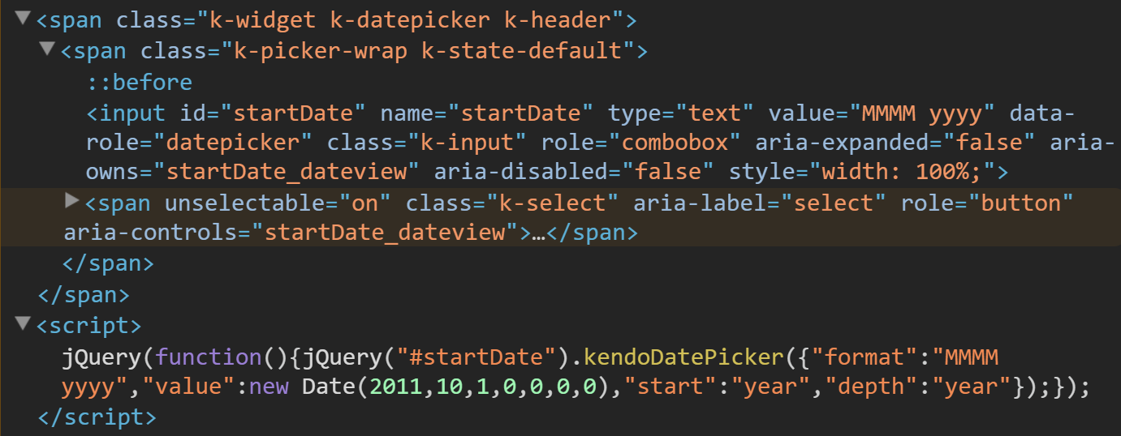
3rd Party Tag Helpers Telerik UI for ASP.NET Core
Index.cshtml
<kendo-datepicker name="startDate" start="CalendarView.Year" depth="CalendarView.Year" format="MMMM yyyy" value='DateTime.Parse("November 2011")' />
Rendered
Notes:
- Mention Dave Paquette’s Bootstrap tag helpers

Slide 12
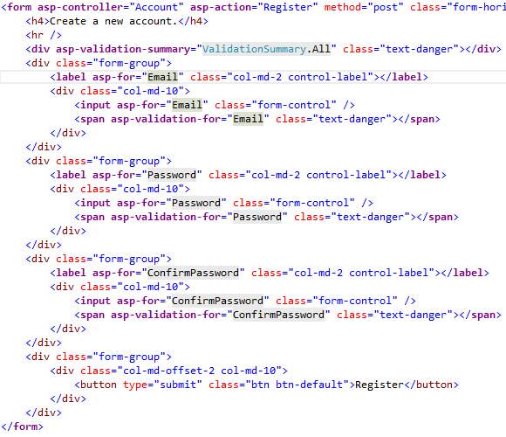
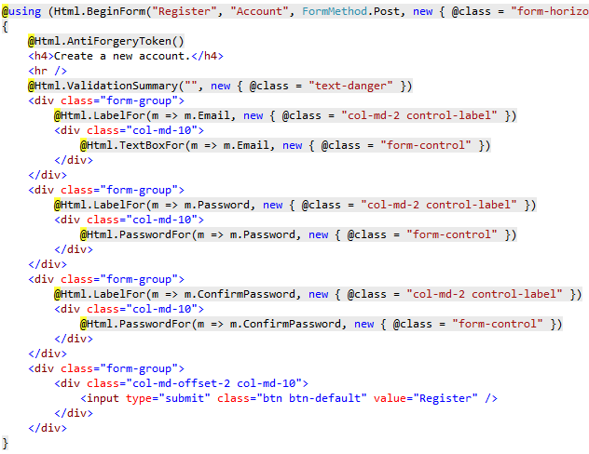
HTML Helpers vs. Tag Helpers Side-by-side Comparison

Slide 13

Demo
Tag Helpers

Slide 14

View Components
Notes:
Similar to partial view
Only depends on data you provide when calling into it

Slide 15
View Components: Overview
ASP.NET Core
Replace Child Actions in ASP.NET Core
Lighter weight
Don’t participate in controller lifecycle
Designed with testing in mind
Notes:
- Can’t use filters w/ them since they don’t participate in lifecycle

Slide 16
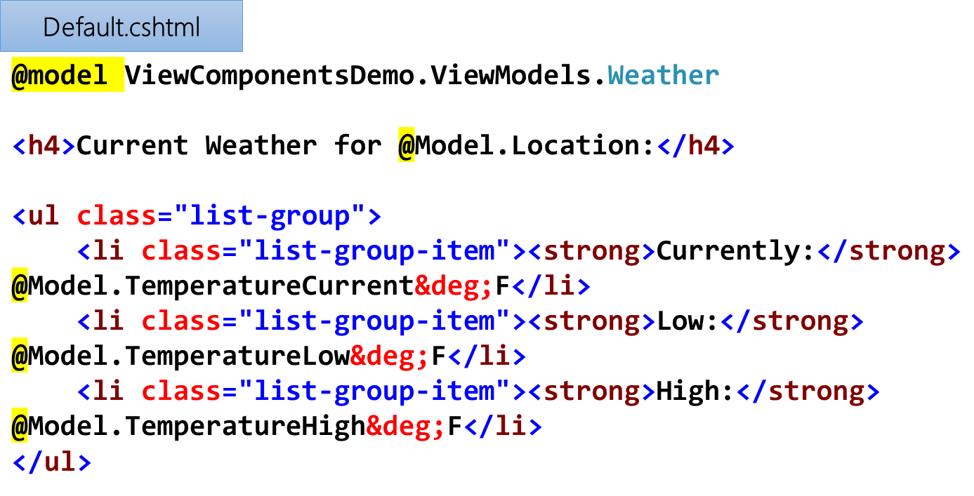
View Components: Anatomy
Class (inherits from ViewComponent)
Razor View
CurrentWeather.cs
public class CurrentWeather : ViewComponent { public async Task<IViewComponentResult> InvokeAsync(string city, string stateAbbrev) { OpenWeatherMapResponse currentWeather = await _svc.GetCurrentWeatherAsync(city, stateAbbrev); VM.Weather weather = currentWeather.MapToWeather(); return View(weather); } }

Slide 17

View Search Paths
Views/<controller_name>/Components/<vc_name>/<view_name>
Views/Shared/Components/<vc_name>/<view_name>
Default view = Default.cshtml
Notes:
Runtime searches in 2 paths
Views/Shared… is recommended path

Slide 18
View Component Invocation Approaches
Index.cshtml
Traditional
Tag Helper
Controller
@await Component.InvokeAsync(nameof(CurrentWeather), new { city = "Chicago", stateAbbrev = "IL" })
Index.cshtml
<vc:current-weather city="Chicago" state-abbrev="IL" />
HomeController.cs
public IActionResult ControllerInvocation() { return ViewComponent(nameof(CurrentWeather), new { city = "Chicago", stateAbbrev = "IL" }); }
Notes:
- Tag Helper ← ASP.NET Core 1.1+ ONLY

Slide 19

Demo
View Components

Slide 20
Recommendations HTML Helpers vs. Tag Helpers
Prefer Tag Helpers when…
Razor isn’t appealing, but HTML is
Testability is important
Prefer HTML Helpers when…
Razor is appealing
Porting app from ASP.NET proper

Slide 21
Recommendations Partial Views vs. View Components
Prefer View Components when…
Complex rendering logic is needed
Testability is important
Tag Helper support is desired
Prefer Partial Views when…
Simplifying large views into small components
Reducing duplication of view content
Porting app from ASP.NET proper
Notes:
VCs enforce Separation of Concerns; PVs don’t
C# code in class vs. C# code in view

Slide 22


Supplementary Resources
Telerik Developer Network article
Building Reusable UI Components
in ASP.NET Core
bit.ly/2uIU7Mc
Eat, Sleep, Code podcast
Implementing ASP.NET Core UIs
bit.ly/2wMgO3p

Slide 23




Thank you!
@Scott_Addie
docs.asp.net
github.com/scottaddie
/TagHelpersDemo
/ViewComponentsDemo
bit.ly/2p7eimM

